Slide 1


COVID-19 analysis deshboard
By Dhanpal Prajapat

Slide 2

Table of contents [presentation outline]
Project Recap
Process
Insights
Summary

Slide 3

Project recap
The problem we are addressing with this project is to analyze and gain insights from the COVID-19 data. The COVID-19 pandemic has had a profound impact on public health, and understanding the data is crucial for decision making and resource allocation. Our goal is to provide valuable insights and create a data-driven dashboard to aid in understanding the pandemic ' s progression and its effects on different countries.

Slide 4
process
Data Understanding & Execution Plan
Data Extraction and Processing
Creating Necessary Aggregated Tables
Analysis & Dashboard Creation
Insights Gathering
Quality Assurance

Slide 5
insights
Confirmed cases
316910296319
Death cases
4419816964
Death Rate
1.39%

Slide 6
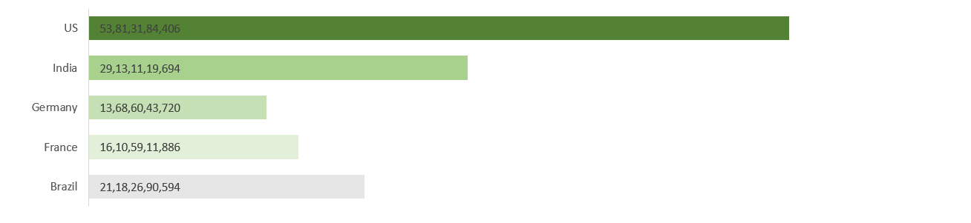
Top 5 countries with highest prevalence of covid-19
These countries have been among the most affected by the COVID-19 pandemic, facing challenges in controlling the spread of the virus, mitigating its impact on healthcare systems, and managing socio-economic consequences.

Slide 7
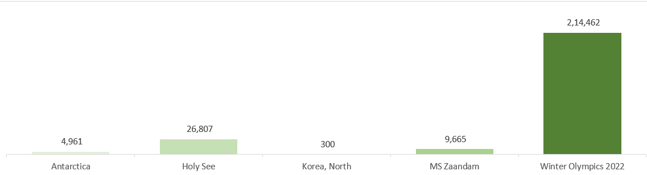
Top 5 countries with lowest prevalence of covid-19
Countries with lower prevalence rates often have governments that have implemented proactive measures such as early lockdowns, strict border controls, comprehensive testing and contact tracing strategies, and effective public health communication campaigns.

Slide 8
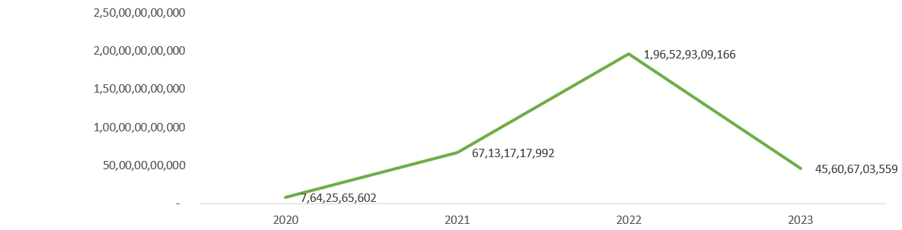
Yearly confirmed cases of covid-19 since 2020
These years, the COVID-19 pandemic has had profound social, economic, and health impacts worldwide.

Slide 9
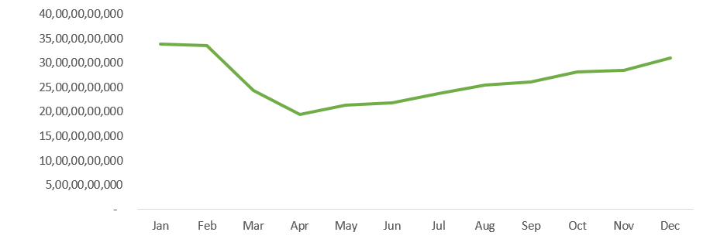
monthly confirmed cases of covid-19
Analyzing confirmed COVID-19 cases by month over the period from 2020 to 2023 can provide valuable insights into the dynamics of the pandemic, the effectiveness of response efforts, and the challenges faced by different regions in controlling the spread of the virus.

Slide 10
summary
In conclusion, our analysis of the COVID-19 situation has yielded valuable insights and actionable information for understanding and managing the pandemic. Through meticulous data preparation, Excel-based reporting, we have achieved the following:
Total Confirmed / Death Cases and Death Rate
Top 5 countries with highest prevalence of covid-19
Top 5 countries with lowest prevalence of covid-19
Yearly Confirmed Cases
Monthly Confirmed Cases
Finally, an Interactive Dashboard which is can be utilized for quick insights gathering, which gives 360 views if filters are utilized.

Slide 11
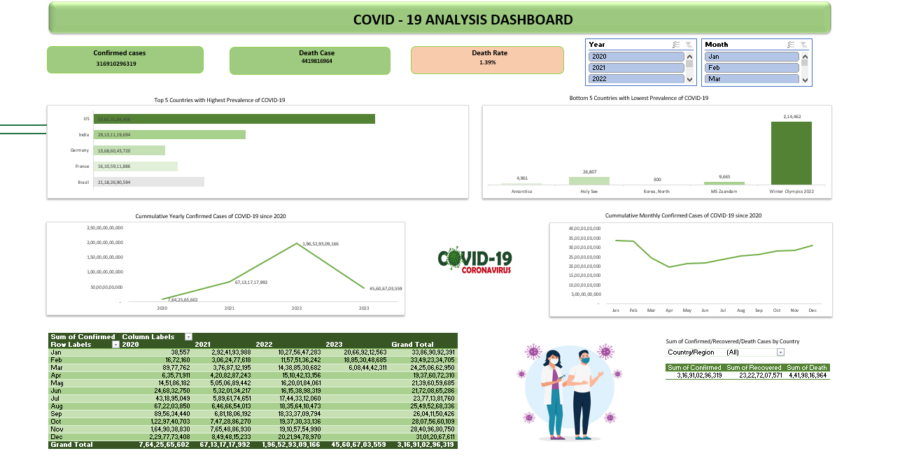
deshboard

Slide 12



Thank you!
Dhanpal Prajapat
dhanpalprajapat7@gmail.com
9468851739

